Slide 1
HP Planet Partners program Ordering process - Bulk collections
October 2020

Slide 2
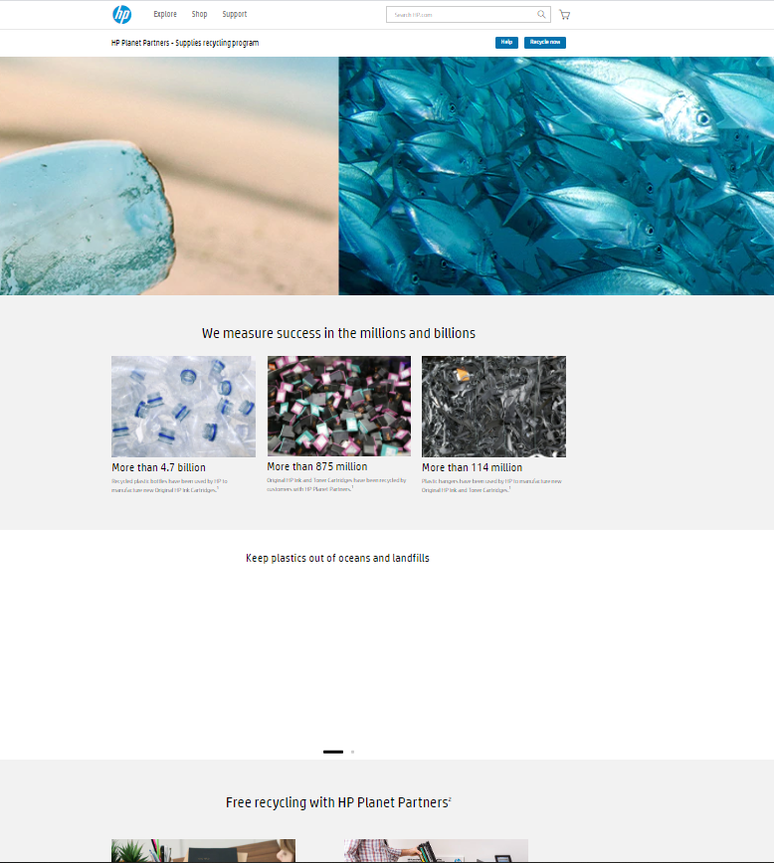
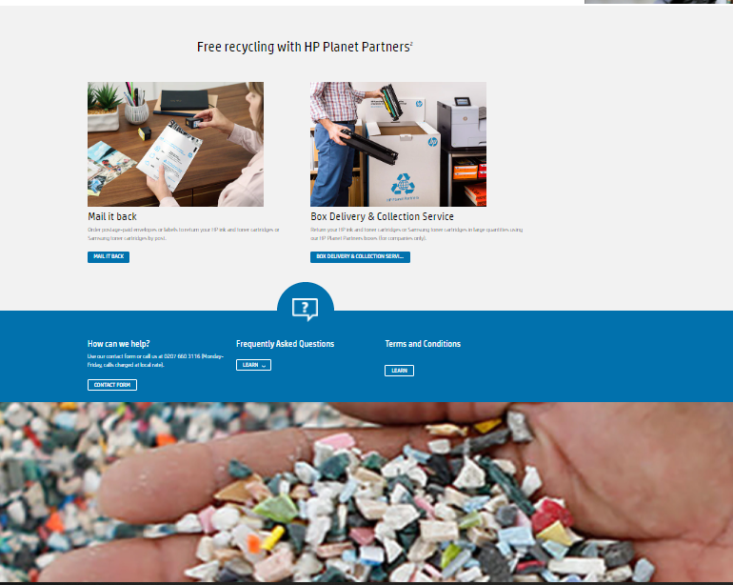
Step 1. Go to hp.com/go/hprecycle.
Click on the blue button “Recycle now” or go down to “Free recycling with HP Planet Partners” and select your option “Mail it back” or “Box delivery & collection services” (depending of the availability in your country)

Slide 3
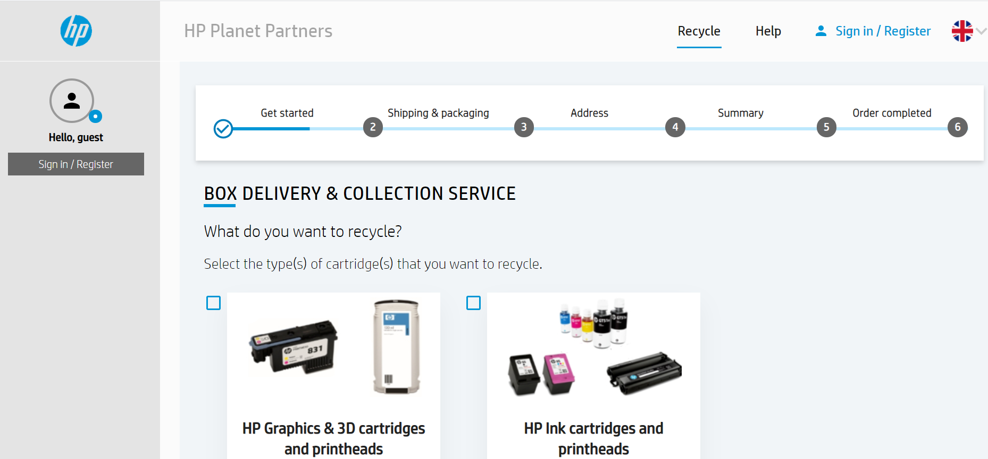
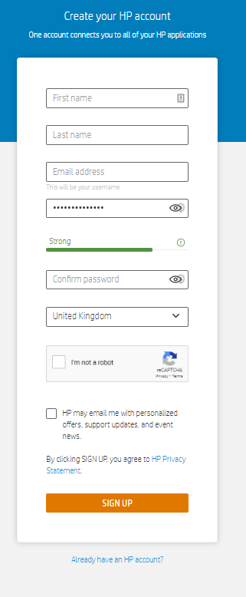
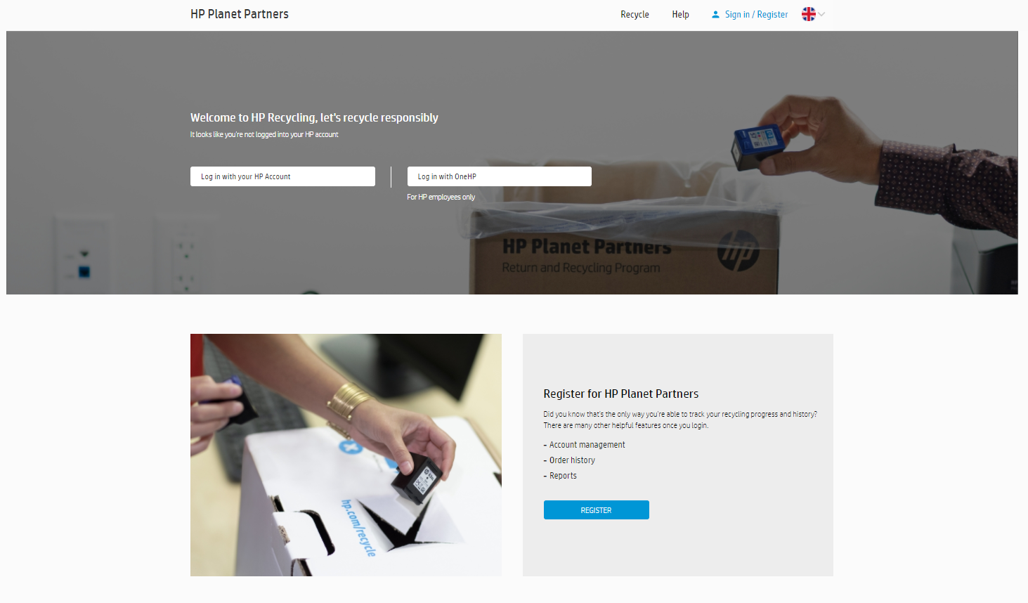
Step 2.1. Registration is now mandatory. Select “Register for HP Planet Partners” in the bottom of the page.
Fill your information, then click on Sign up.

Slide 4
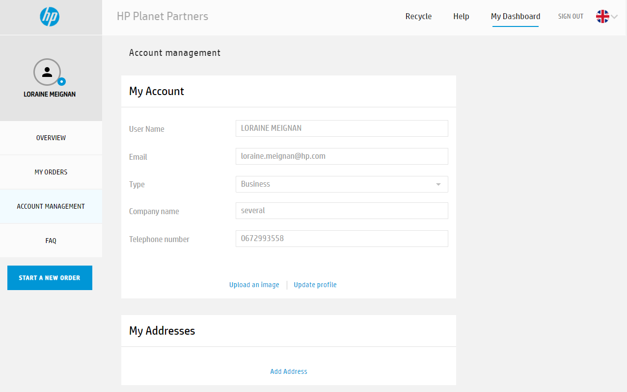
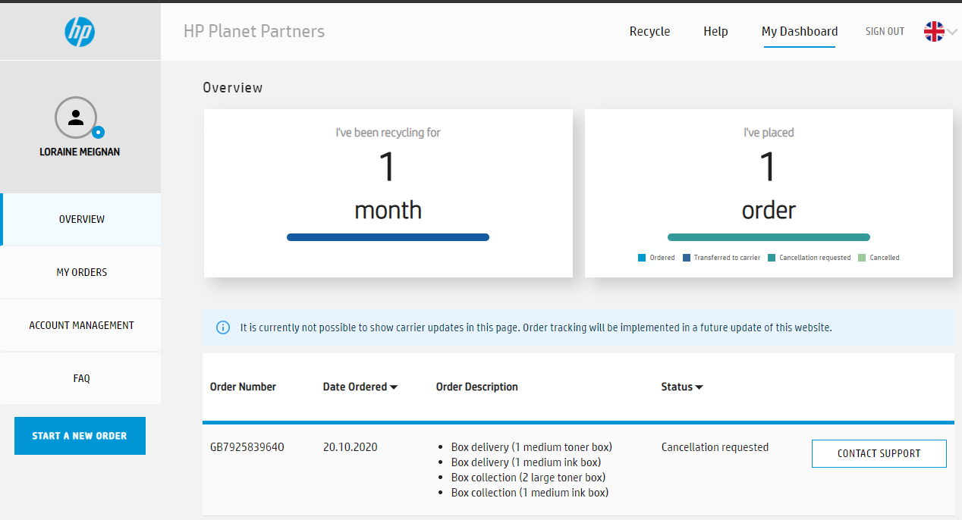
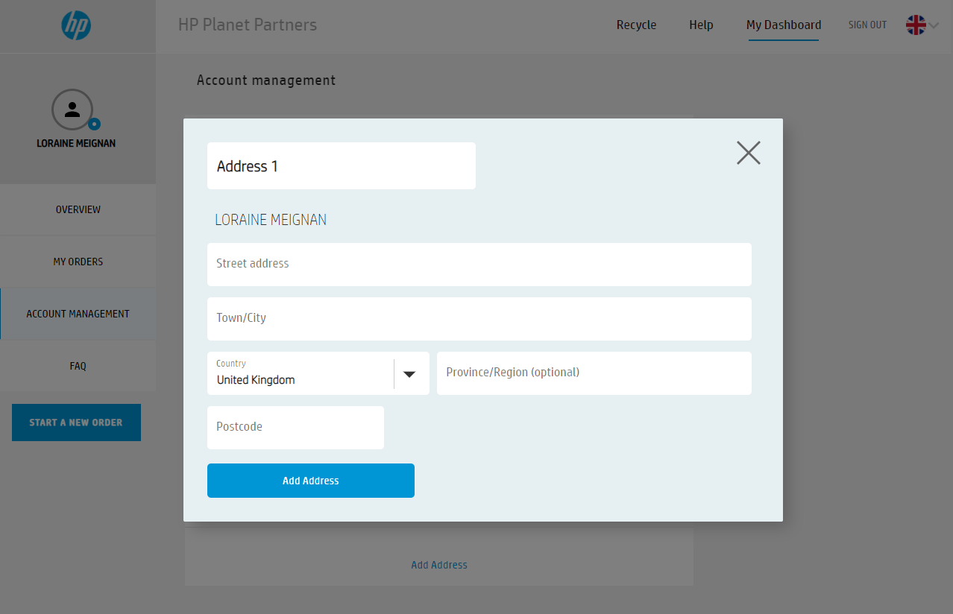
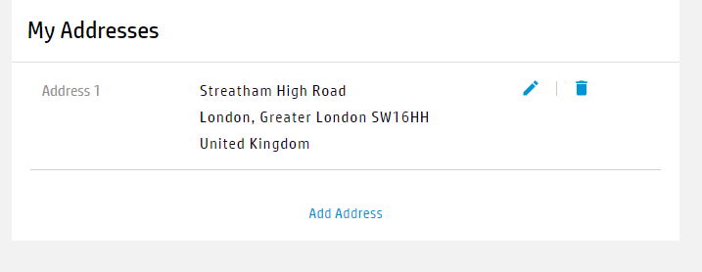
Step 2.3. Fill your address
Step 2.2. In My Dashboard, select Account Management

Slide 5
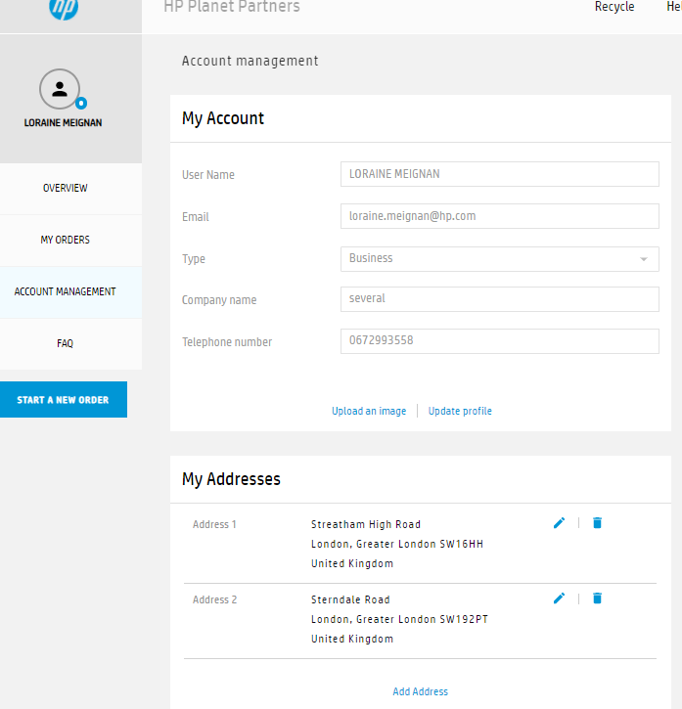
Step 2.4. Managed your address, contact… in Account Management part
You can add all address you need. Modify or delete.
You can managed all the order of your account, branches…
If you need to change the contact name for delivery or colllection,
you can do that in the end of the order (slide 8)

Slide 6
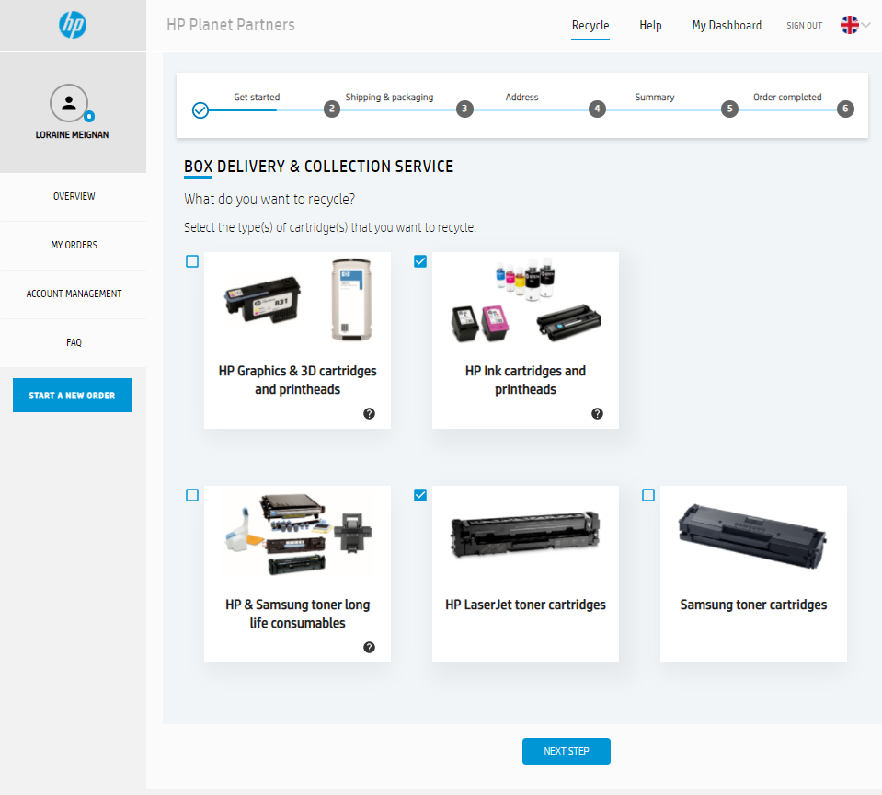
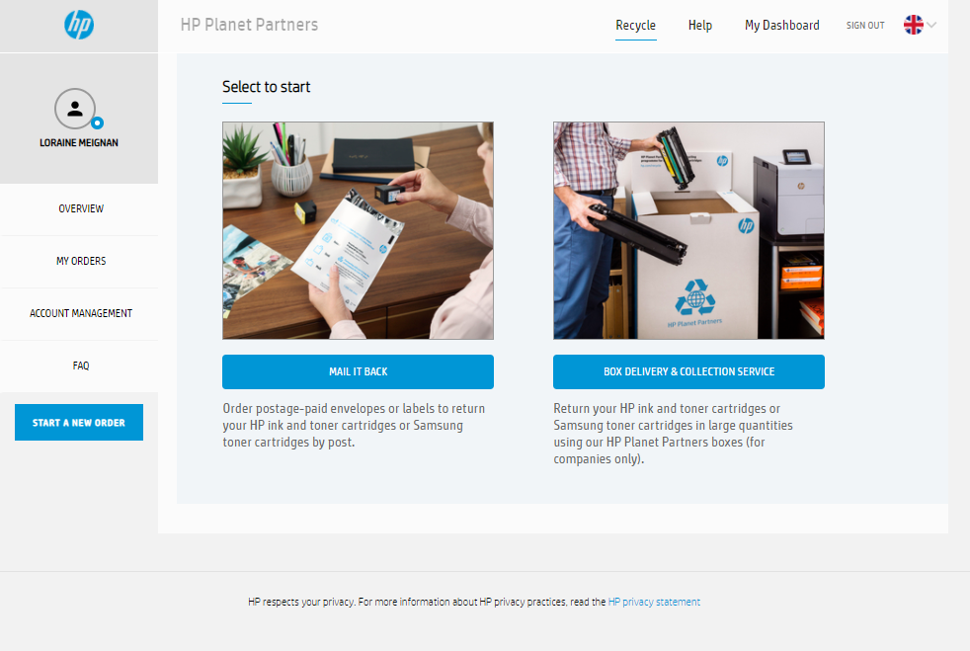
Step 3. Select the better option for you - Mail it back
- Box delivery & Collection service
Step 4.1. Select the type of cartridges that you want to recycle

Slide 7
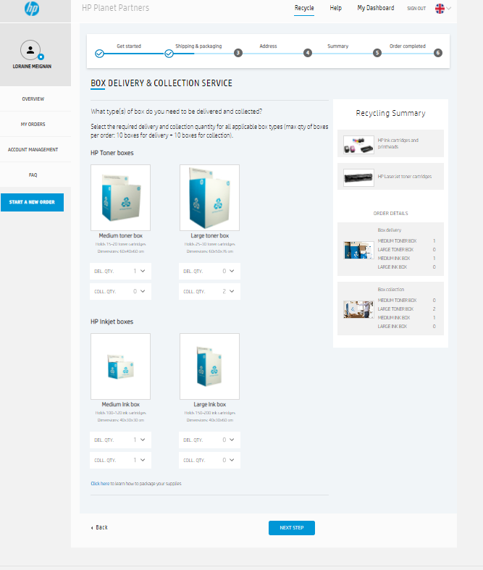
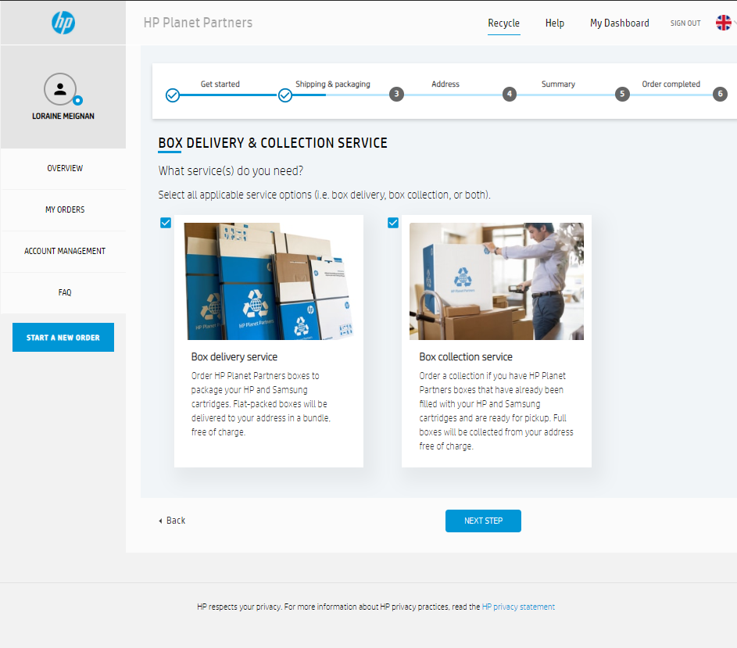
Step 4.2. Select box delivery, box collection or both and click “Next step”
Step 4.3. Fill number of boxes to deliver, collect or both and click “Next step”

Slide 8
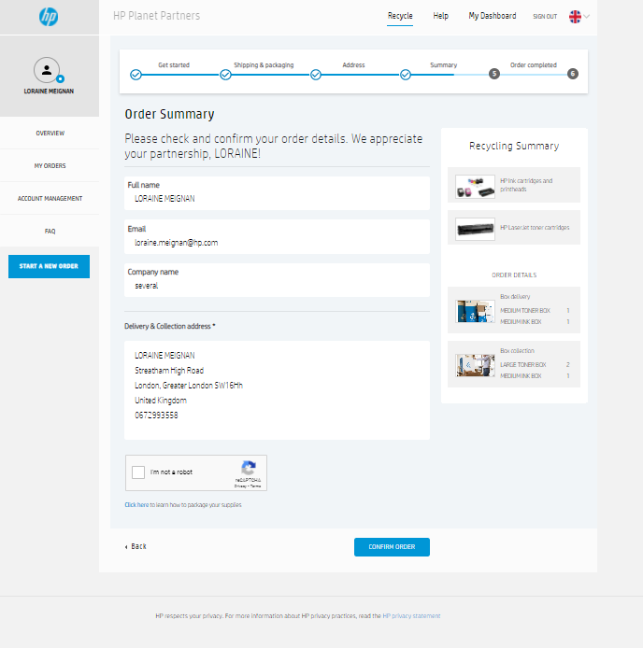
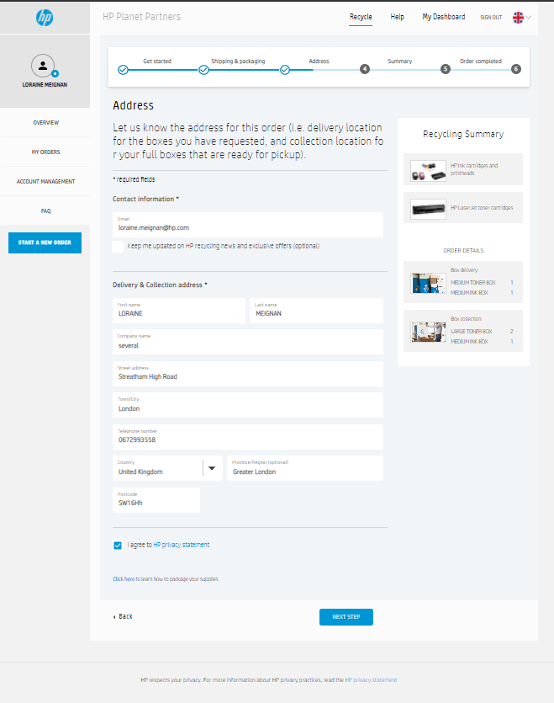
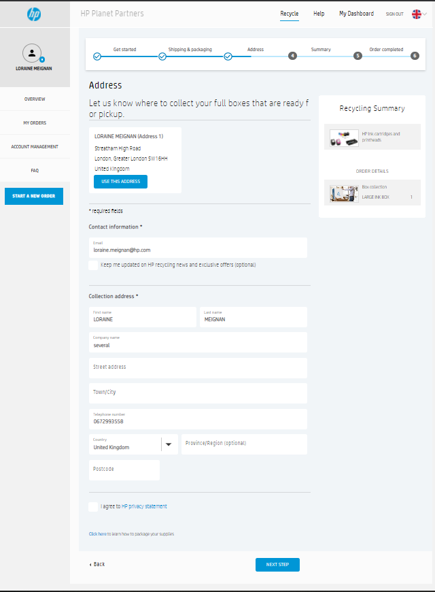
Step 4.4. The first time, fill your address information or if you registered it, click on “Use this address”
Step 4.5. Check your information and confirm your order

Slide 9
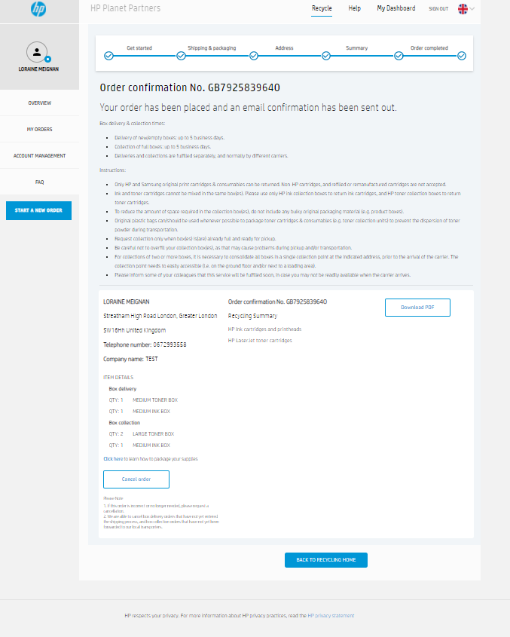
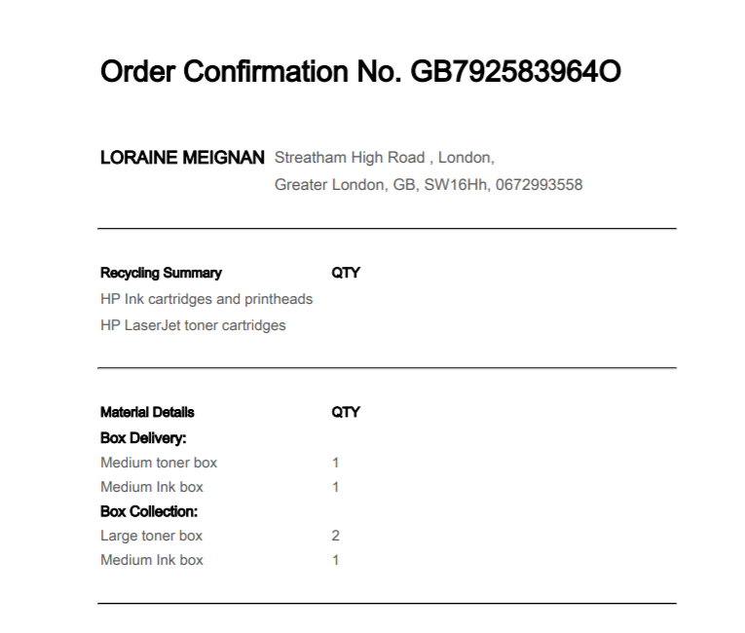
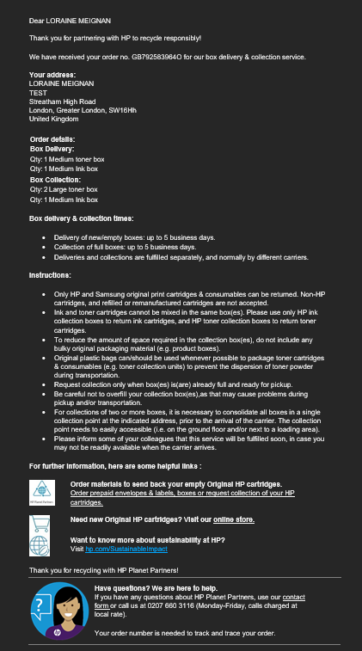
Step 4.6. Order confirmation number
Step 4.7. Email confirmation

Slide 10
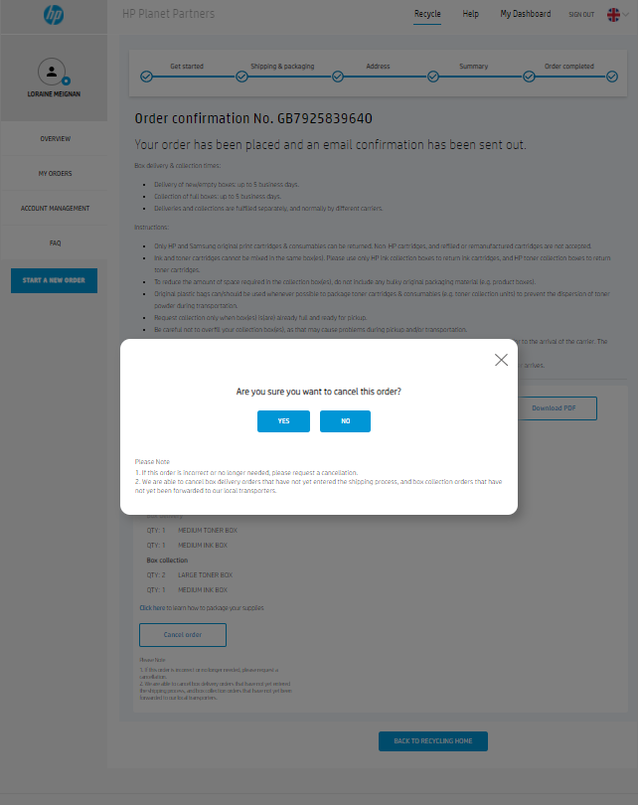
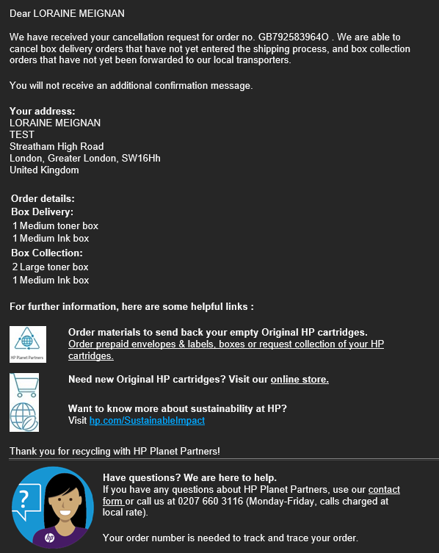
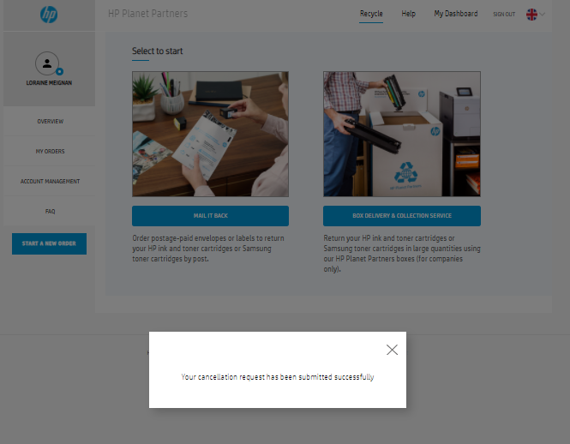
Step 4.8. Cancel your order
Step 4.9. Cancel confirmation email

Slide 11
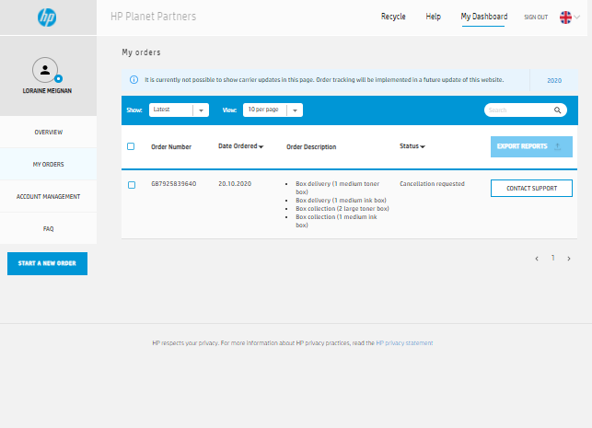
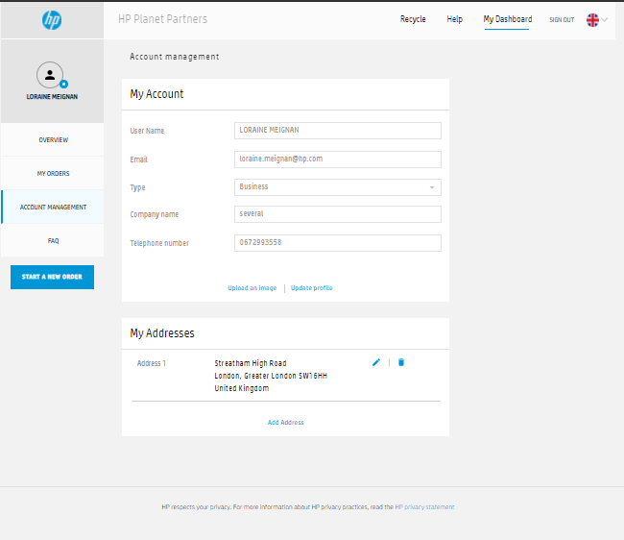
Step 5. Manage your order
Step 6. Manage several address

